Slide 1
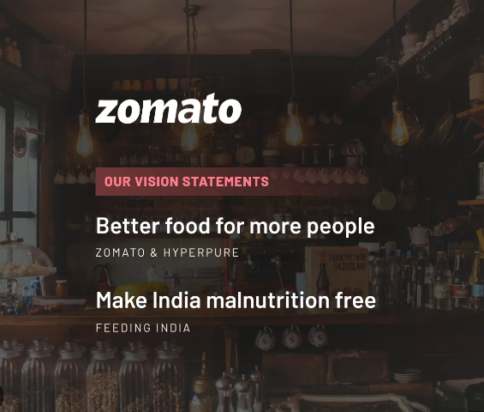
Zomato's Restaurant Insights Dashboard
Notes:
"Good [morning/afternoon/evening] everyone. Today, I will be presenting the Zomato's Restaurant Insights Dashboard. This project aims to provide a comprehensive analysis of restaurant data available on Zomato, with a focus on key metrics like cost, ratings, and availability of online services. Let's dive into the presentation."

Slide 2
ACKNOWLEDGEMENT
On the very outset of this Presentation , I would like to extend my profound gratitude and indebtedness to Mr. Adit Agarwal , Founder of NoQS Digital, under whose constant support and guidance throughout this project , we can complete this project. His Inspiring intellectual guidance, constructive criticism and valuable suggestions helped us a lot.
Notes:
before we begin, I would like to express my profound gratitude to Mr. Adit Agarwal, the Founder of NoQS Digital, whose guidance and support were invaluable in the completion of this project.

Slide 3
CONTENT
Meet the team
Overview of the Dataset used
Introduction to Zomato's Restaurant Insights
Key Metrics Overview
Average Cost of Two People in Different Restaurants
Distribution of Restaurant based on Ratings
Availability of Online Ordering and Table Booking
Key findings and Recommendations
Most Expensive Restaurant Types and Most Expensive Areas
Working mechanism of Dashboard
Key findings and Recommendations
Conclusion
Q&A
Notes:
"Here's a quick overview of what we will cover today: We’ll start by meeting the team behind this project, then move on to discuss the dataset we used. I'll introduce the Zomato Restaurant Insights dashboard, walk through the key metrics, and highlight the findings. We'll also explore the working mechanism of the dashboard, followed by recommendations and conclusions. Finally, we’ll have some time for Q&A."

Slide 4
Overview Of Data Set
Restaurant Name
Restaurant Type
Rating out of 5
Number Of Ratings
Average Cost of 2 Person
Online Order
Table Booking
Cuisines Types
Area
Address
Total no. of Entries: 7038
Total no. of fields: 10
zomato INSIGHTS.xlsx
Notes:
"The dataset we used for this analysis contains detailed information about 7,038 restaurants. The fields include restaurant names, types, ratings, number of ratings, average cost for two people, online ordering availability, table booking options, cuisine types, and area. This dataset is rich in insights, which we will explore in the following slides."

Slide 5


Introduction to Zomato's Restaurant Insights
Purpose: To provide a comprehensive analysis of restaurant data on Zomato.
Focus: General analysis across all cuisines.
Data: Key metrics derived from, no. of restaurant , ratings and cost data.
Notes:
The purpose of this dashboard is to provide a comprehensive analysis of restaurant data on Zomato, focusing on general trends across all cuisines. We’ve derived key metrics from restaurant ratings, cost data, and service availability to help us understand the restaurant landscape better."

Slide 6

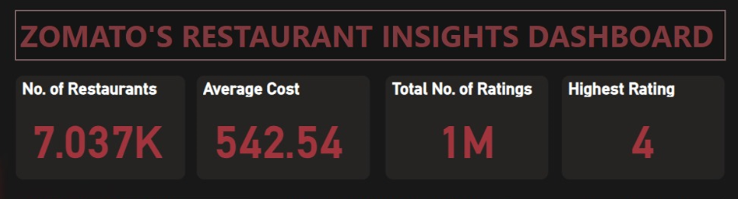
Key Metrics Overview
Cost in (INR)
Notes:
These metrics provide a quick snapshot of the overall restaurant scene as represented in our dataset."

Slide 7
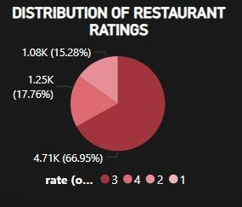
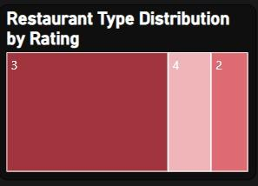
Distribution of Restaurant based on Rating
Notes:
Fig 2 - Max no of rest is 3 rating like suppose BAR/fine dining type rest. Getting 3 rating

Slide 8
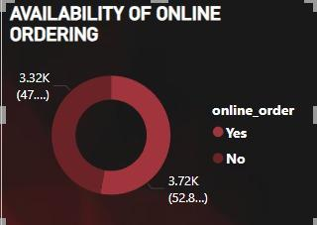
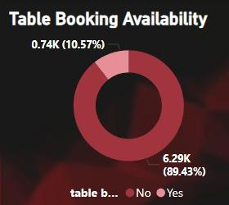
Availability of Online Ordering and Table Booking
This pie chart shows availability of online ordering is 53%
This pie chart shows table booking availability is only 11% .
Notes:
One of the key aspects we analyzed is the availability of online ordering and table booking services. The pie charts here show that a significant number of restaurants offer these services, reflecting the growing consumer demand for convenience and flexibility."

Slide 9
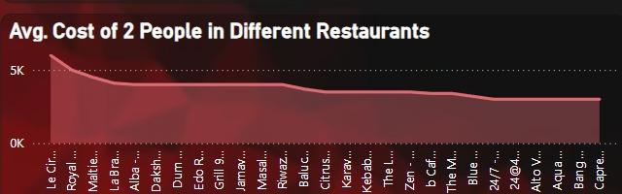
Average Cost of Two People in Different Restaurants
As we can see from this graph Le cirque signature and royal afgan is expensive here avg cost of two people is more than 5k
Notes:
As we can see from this graph Le cirque signature and royal afgan is expensive here avg cost of two people is more than 5k .This cost variation is likely influenced by factors such as location, restaurant type, and the target demographic."

Slide 10
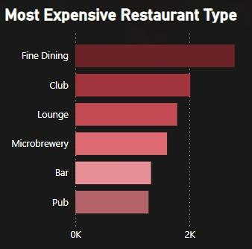
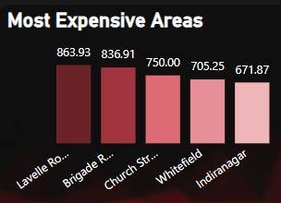
Most Expensive Restaurant Types and Most Expensive Areas
Fine Dining category is most expensive.
Most Expensive Area is Lavelle Road.
Notes:
This slide highlights the most expensive restaurant types and areas. Fine Dining emerges as the priciest category, followed by clubs and lounges. In terms of locations, Lavelle Road stands out as the most expensive area. This information is crucial for strategic planning and marketing."

Slide 11
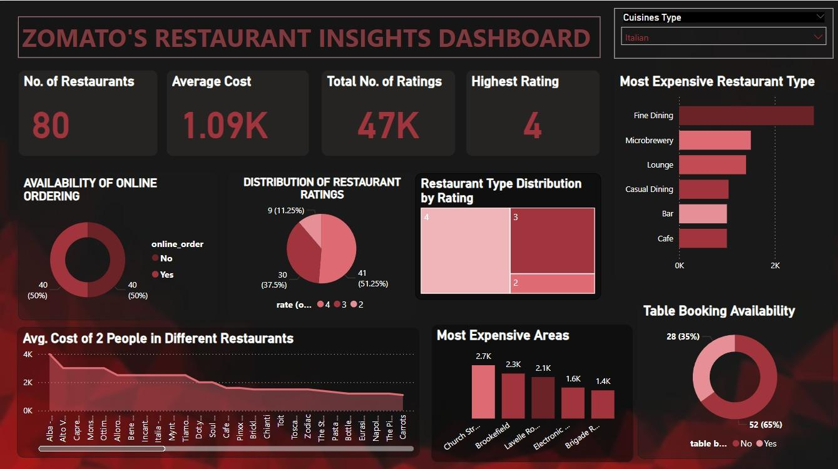
Working Mechanism

Slide 12
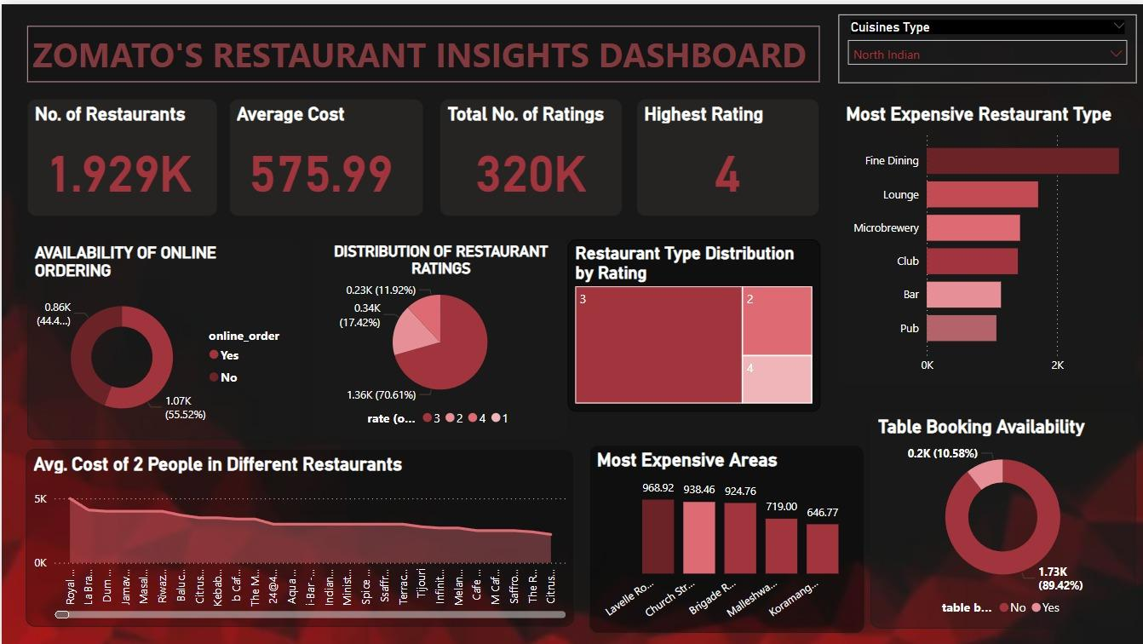
Working Mechanism

Slide 13
Key findings and Recommendations
Key Findings:
Significant number of restaurants with online ordering and table booking.
High concentration of top-rated restaurants.
Fine Dining and specific areas like Lavelle Road are notably expensive.
Recommendations:
Focus marketing efforts on high-cost areas.
Explore partnerships with top-rated restaurant types.
Enhance services like online ordering and table booking to meet customer expectations.
Notes:
From our analysis, we've observed a high concentration of top-rated restaurants and a significant number offering online ordering and table booking. Fine Dining and areas like Lavelle Road are notably expensive. Based on these findings, we recommend focusing marketing efforts on high-cost areas, exploring partnerships with top-rated restaurant types, and enhancing services like online ordering and table booking to meet customer expectations."

Slide 14
Conclusion
The analysis reveals a diverse restaurant landscape with a substantial number of highly-rated establishments.
Most restaurants offer online ordering and table booking, reflecting a strong alignment with consumer preferences.
These insights can guide strategic decisions for marketing, partnerships, and service enhancements to better cater to customer needs and maximize business potential. ​​
Notes:
"In conclusion, our analysis reveals a diverse restaurant landscape with many highly-rated establishments. The strong alignment with consumer preferences in online ordering and table booking suggests opportunities for further enhancing services. These insights can guide strategic decisions for marketing, partnerships, and service improvements to better cater to customer needs and maximize business potential."

Slide 15
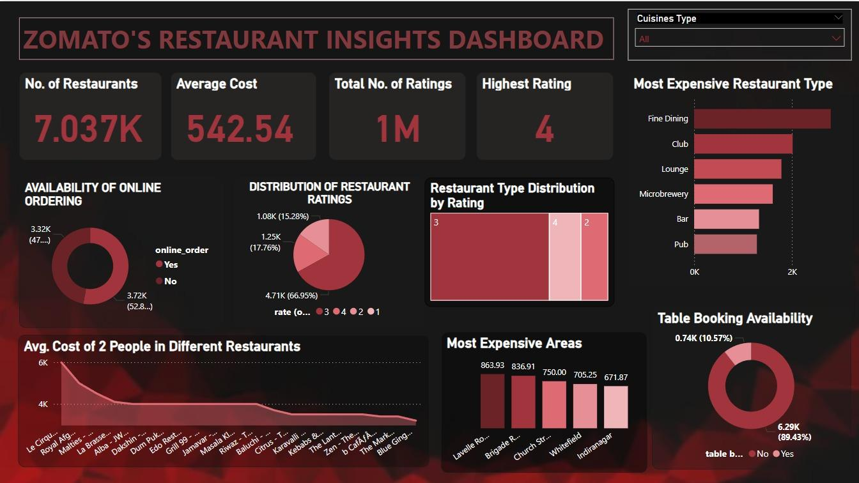
OUR DASHBOARD

Slide 16
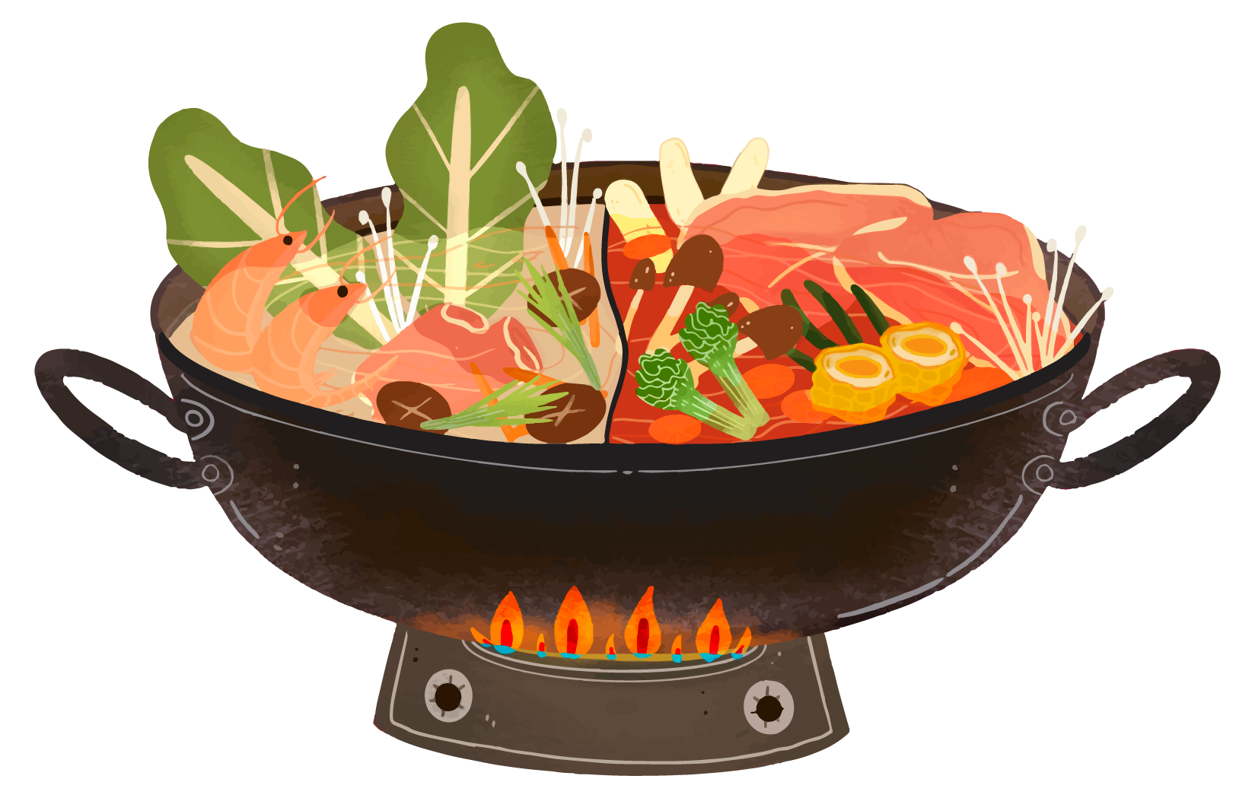





Thank you for your time!!
Q&A

